Slide 1

Angular

Slide 2
What is Angular
Angular is an application design framework and development platform for creating efficient and sophisticated single-page apps.
A single-page application (SPA) is a web application or website that interacts with the user by dynamically rewriting the current web page with new data from the web server, instead of the default method of the browser loading entire new pages.

Slide 3
Challenges
Typescript
Templating system ( structural directives )
Data binding

Slide 4
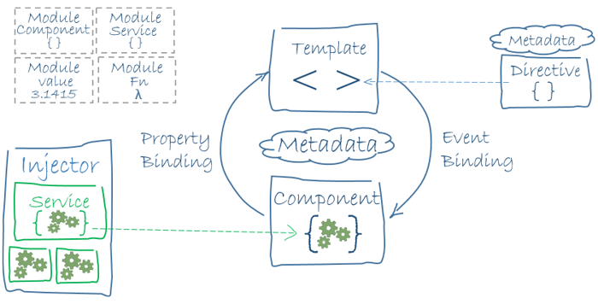

Slide 5
Let’s get started
You will need node/npm
Create your first
Angular app using Angular CLI

Slide 6
Create angular application using Angular CLI
Open git bash terminal and then follow those steps:
Install Angular CLI
npm install -g @angular/cli
Create a new angular app using this command
ng new <nume aplicatie> --routing=true --style=scss
Go to the new folder created
cd <nume aplicatie>
start development server using this command:
ng serve

Slide 7
Let’s discuss about the folder structure

Slide 8
Modules
The basic building blocks of an Angular application are NgModules, which provide a compilation context for components. NgModules collect related code into functional sets; an Angular app is defined by a set of NgModules. An app always has at least a root module that enables bootstrapping, and typically has many more feature modules.
Components define views, which are sets of screen elements that Angular can choose among and modify according to your program logic and data.
Components use services, which provide specific functionality not directly related to views. Service providers can be injected into components as dependencies, making your code modular, reusable, and efficient.
Both components and services are simply classes, with decorators that mark their type and provide metadata that tells Angular how to use them.

Slide 9
Data binding
[ ] - Property binding One-way from data source to view target
[target]="expression"
bind-target="expression"
We can use bind- instead of []
() -> Event Binding One-way from view target to data source
(target)="statement"
on-target="statement"
We can use on- instead of ()
[()]- Two way Binding
[(target)]="expression"
bindon-target="expression"
We can use bindon- instead of [()]

Slide 10
Built-in attribute directives
Many NgModules such as the RouterModule and the FormsModule define their own attribute directives. The most common attribute directives are as follows:
NgClass—adds and removes a set of CSS classes.
NgStyle—adds and removes a set of HTML styles.
NgModel—adds two-way data binding to an HTML form element.

Slide 11
Structural Directives
Structural directives are responsible for HTML layout. They shape or reshape the DOM's structure, typically by adding, removing, or manipulating elements.
As with other directives, you apply a structural directive to a host element. The directive then does whatever it's supposed to do with that host element and its descendants.
Structural directives are easy to recognize. An asterisk (*) precedes the directive attribute name as in this example.

Slide 12
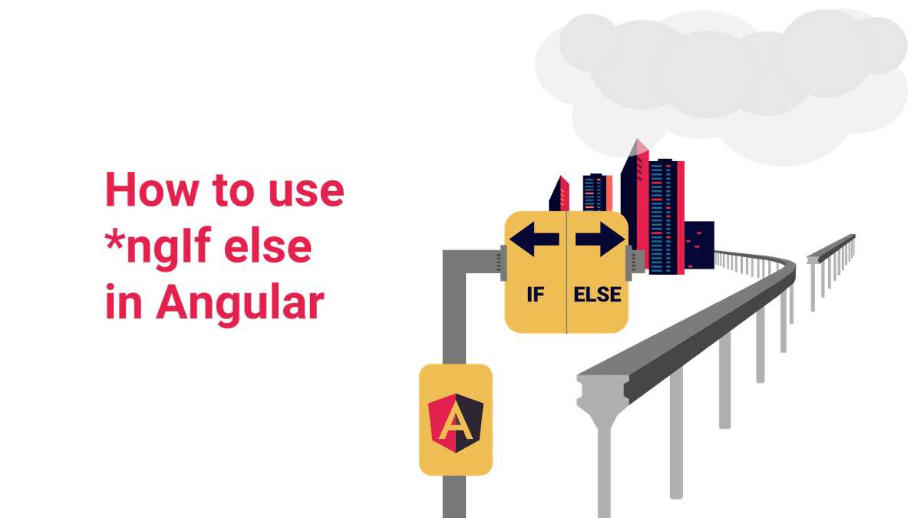
*ngIf

Slide 13
*ngIf
NgIf is very useful if you want to show or hide parts of your application based on a condition.
Based on that flag, a certain HTML element is added or removed from the DOM:
<p>Show this all the time</p>
<p *ngIf="show">Show this only if "show" is true</p>

Slide 14
*ngIf vs [hidden]
At first sight, the angular ngIf directive seems to just the same thing as binding to the HTML5 "hidden" attribute. So why do we need two ways to do the same thing?
While the hidden attribute is literally hiding the selected part of the DOM, just like the CSS "display: none" property, the element still sit on the DOM. They are just invisible.
Angulars' ngIf directive, on the other hand, is completely removing the selected part from the DOM. The great advantage of that is, that this method is not interfering with any CSS-Style-sheets at all. It is simply removing anything.

Slide 15
Working with "else"
Just as we are used to from other programming languages, the angular ngFor directive does also allow us to declare an else-block. This block is shown if the statement defined in the main block happens to be false.
<div *ngIf="show; else notShow">
<p>Show this only if "show" is true</p>
</div>
<ng-template #notShow>
<p>Show this only if "show" is not true</p>
</ng-template>

Slide 16
NgIf also has a "then"
In some rare cases, it might be useful to have the ngIf directive from its actual result-block. This would enable us to swap the result of the block out on the fly, by just referencing another ng-template.
<ng-template *ngIf="show;then showBlock; else notShowBlock"></ng-template>
<ng-template #showBlock>
<p>Show this only if "show" is true</p>
</ng-template>
<ng-template #notShowBlock>
<p>Show this only if "show" is not true</p>
</ng-template>

Slide 17
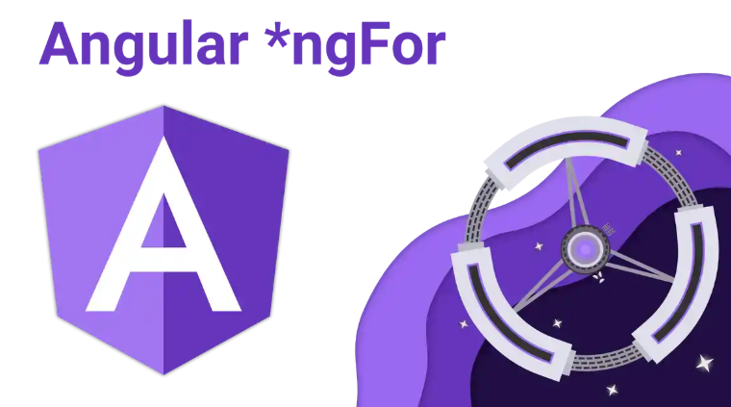
*ngFor

Slide 18
*ngFor
The so-called ngFor directive is a core directive, that comes with the angular framework itself.
We can use this directive, if we want to display a dynamic list, for example, an array of elements on the screen.
<ul>
<li *ngFor="let element of array">{{element.name}}, {{element.age}}</li>
</ul>

Slide 19
*ngFor - How to get the index of each element
To get the index of each element, we can define another variable in the ngFor directive. We can name that variable however we like. Let's call it "i" for now. To get the value of the index, we also need to assign "index" to that variable.
<ul>
<li *ngFor="let element of array; let i = index">{{i}}. {{element.name}}, {{element.age}}</li>
</ul>

Slide 20
Template reference variable
A template reference variable is often a reference to a DOM element within a template. It can also be a reference to an Angular component or directive or a web component. That means you can easily access the variable anywhere in the template.
<input type="text" #lastNameInput> <button (click)="show(lastNameInput)">Show</button>
show(lastName: HTMLInputElement){
console.log(lastName.value);
}

